Slide 1
RFSkill EM-Dedicated PCell User Guide
Edward Yeuan and Yu-Jiu Wang
2015

Slide 2
Overview
PCell with two flavors: Cadence PCell and PDK PCell
Cadence Pcell is the standard cadence Pcell; drawing shapes using dbCreatePolygon, dbCreateRect, dbCreate… function.
However, we want to support EM-port, 3D packaging, 3D connector, these cannot be inherenetly supported by cadence. To do this, we need to create PDK Pcell through string template.
Both Pcell can be managed by the IDE.
RFSkill
String Template
HFSS VBScript
Cadence PCell
(RFSkill)
Cadence PCell
(VBScipt Class)
Compiler
PDK PCell
(RFSkill)
PDK PCell
(VBScipt Class)

Slide 3
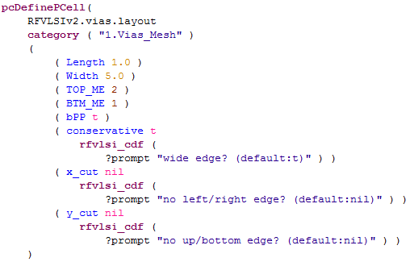
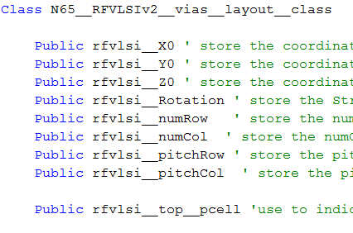
Compiling Cadence PCell
One-to-one-translated PCell Class by string template
Compiled to Cadence Standard PCell Library
Mainly composed of drawing functions, i.e. rectangle, polygon…
Compiler
Translated

Slide 4
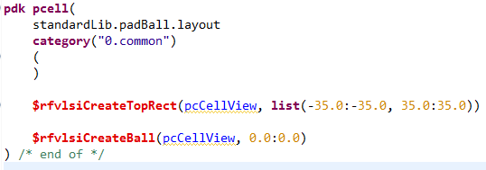
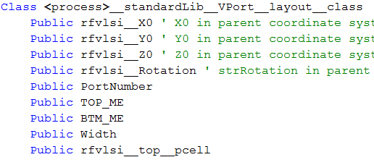
Compiling PDK PCell
Pre-defined PCell Class in tool-dependent string template , inside print_StatConfigProcessName section. (advanced)
The Pcell itself will not generate the target code, but through tool-dependent string template.
Dedicated to EM functions or 3D drawing functions in HFSS
i.e. port, bondwire, solder ball, SMA connector, antenna structure…
Pre-defined

Slide 5
Implementing Arbitrary EM-Dedicated PCell
Define EM-dedicated PCell Class in string template
Construct PCell in RFSkill platform with dimensions
From now on, the EM-dedicated PCell maps to the pre-defined Class
In other words, we are creating a PCell with no function in Cadence but with EM-related function in HFSS.
Nonetheless, we are able to call the PCell in Cadence and map to the EM-dedicated function through the RFSkill compiler.
The RFSkill platform integrates all the PCells (both Cadence and PDK).

Slide 6
VPort Example

Slide 7
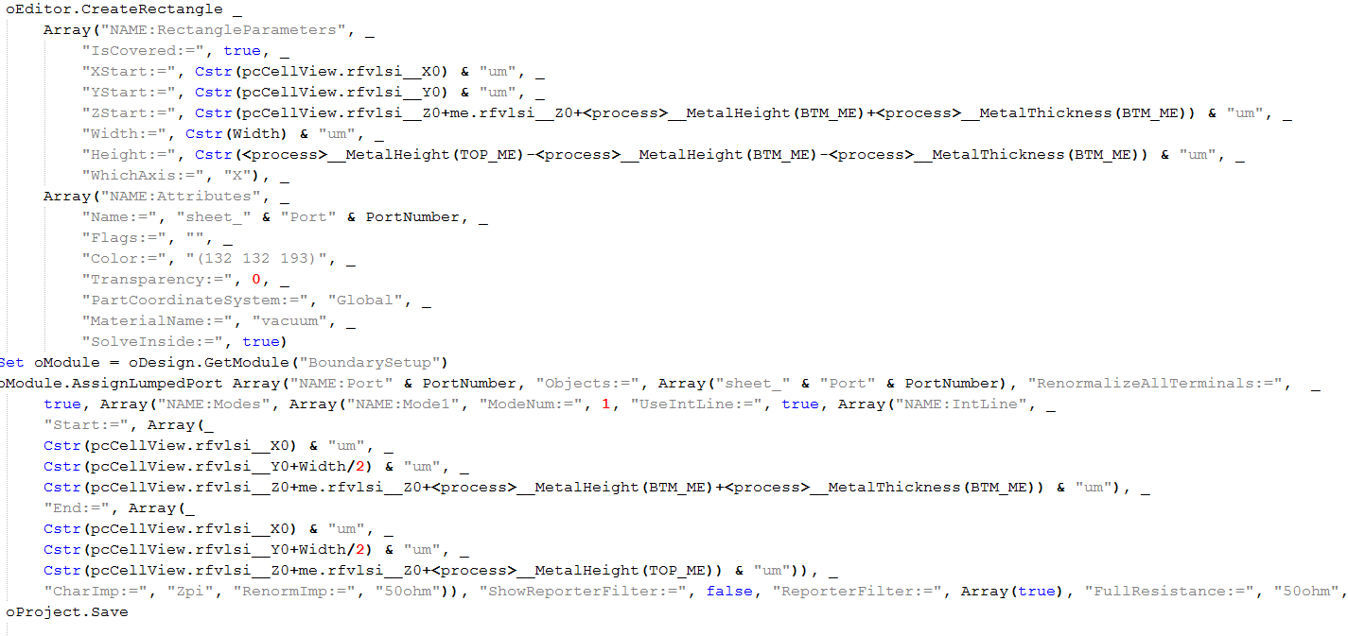
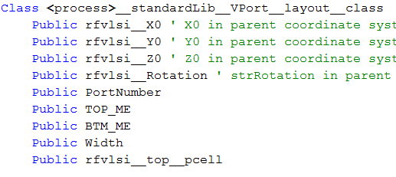
String Template
VBScript Class pre-defined in String Template

Slide 8
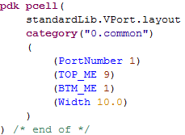
RFSkill PCell
Specifying dimensions for usage

Slide 9
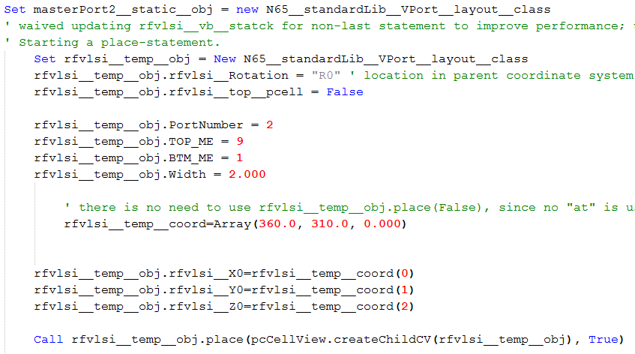
Compiler Output
TopCell calls the pre-defined VBScript Class
Calling

Slide 10
Implemented PDK PCells

Slide 11
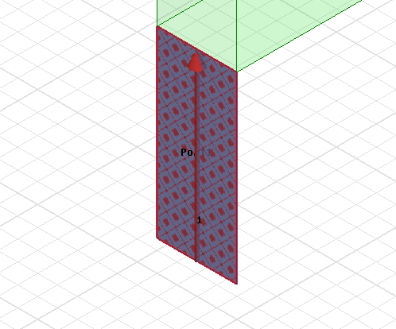
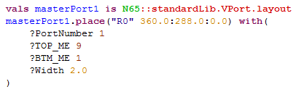
VPort
Vertical Port

Slide 12
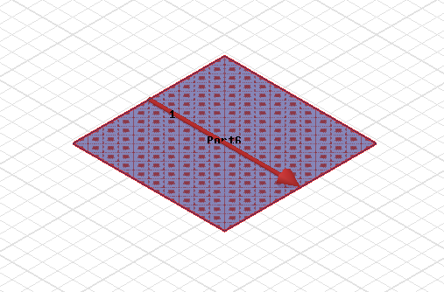
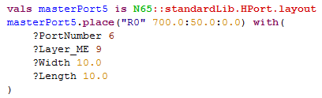
HPort
Horizontal Port

Slide 13
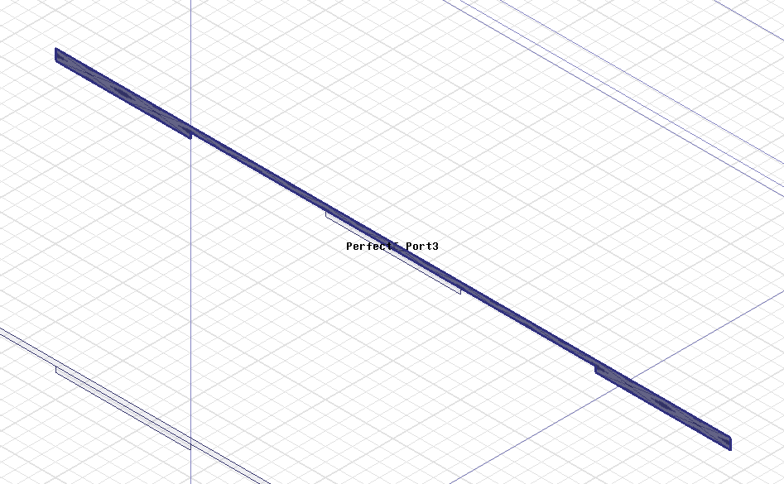
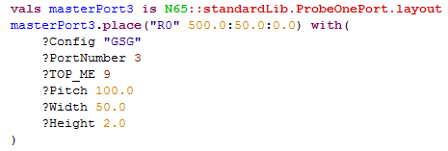
ProbeOnePort
GSG, GS, SG configuration available

Slide 14
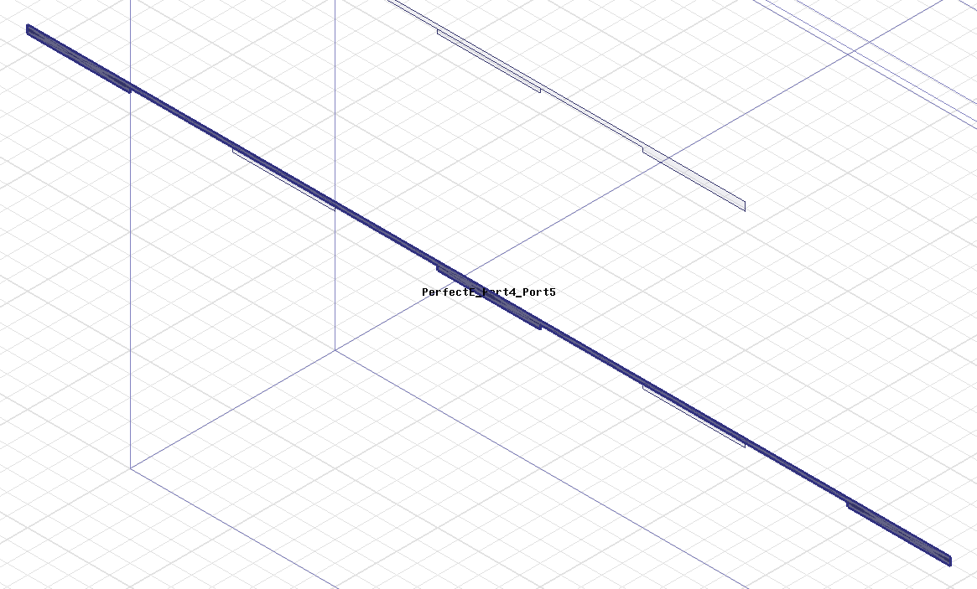
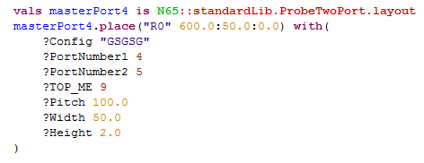
ProbeTwoPort
GSGSG, GSSG, SGS configuration available

Slide 15
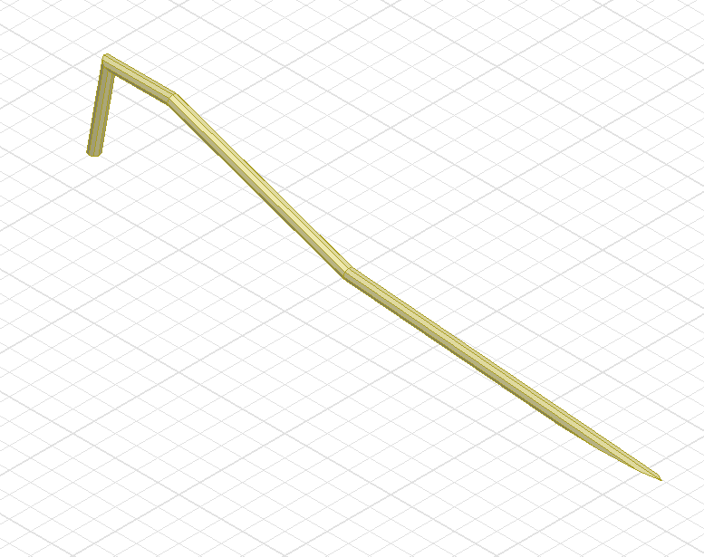
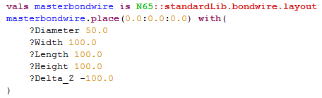
bondwire

Slide 16
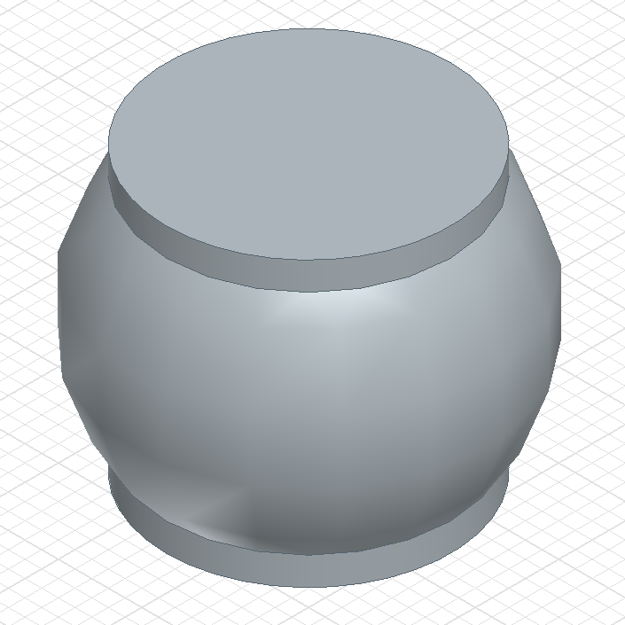
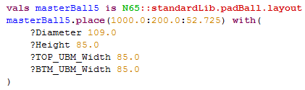
padBall

Slide 17
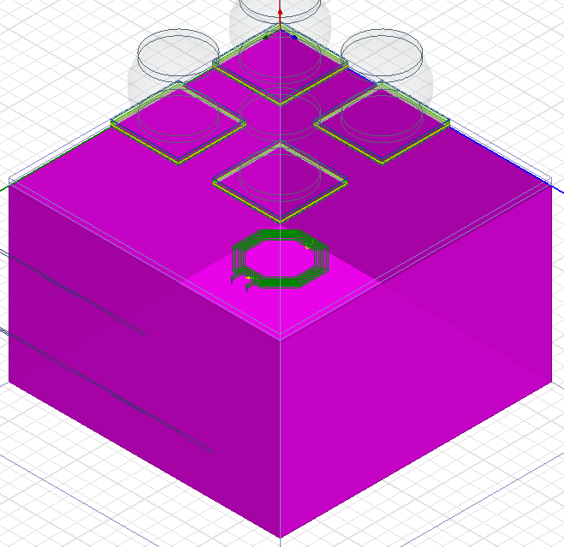

die

Slide 18
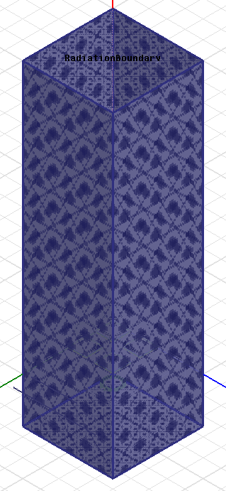
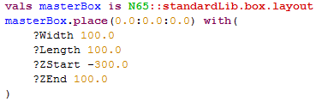
box

Slide 19
Implemented Testbench PCells

Slide 20
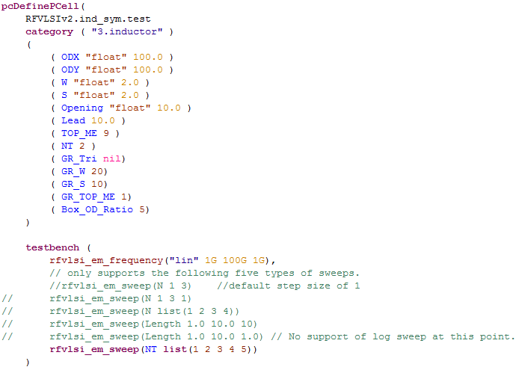
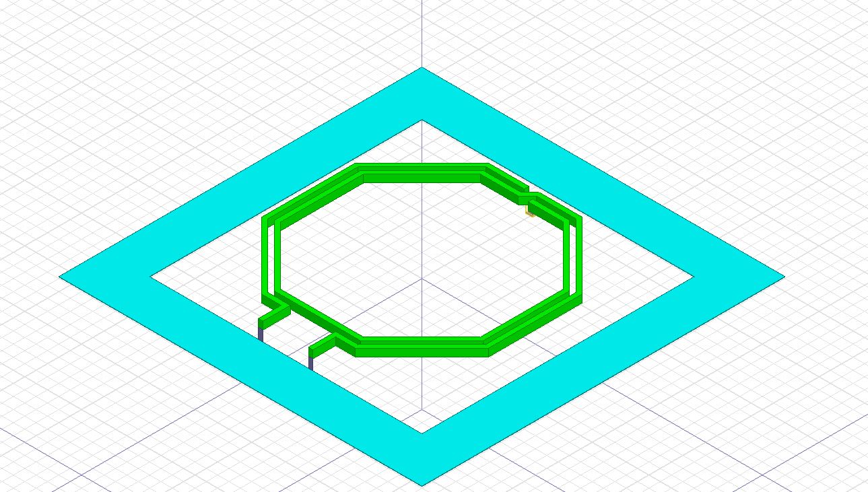
ind_sym_testbench

Slide 21
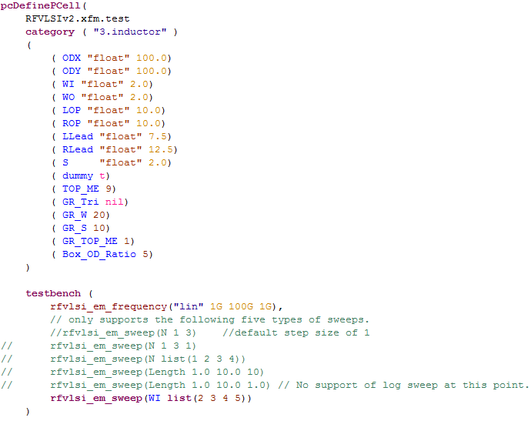
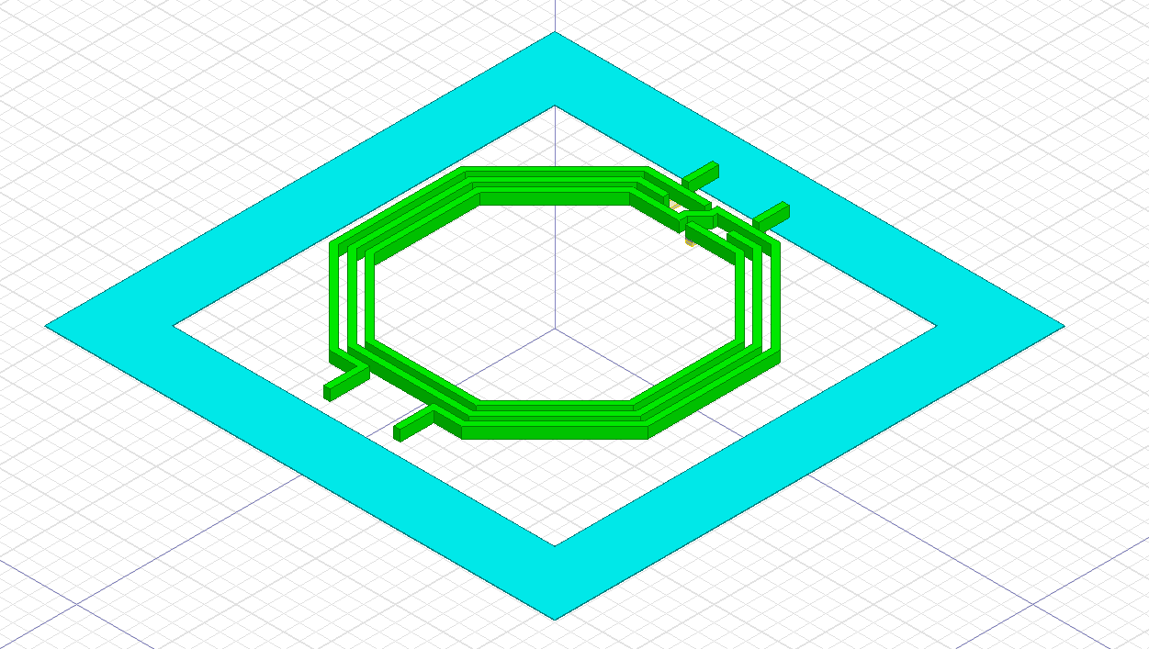
xfm_testbench

